Slide 1
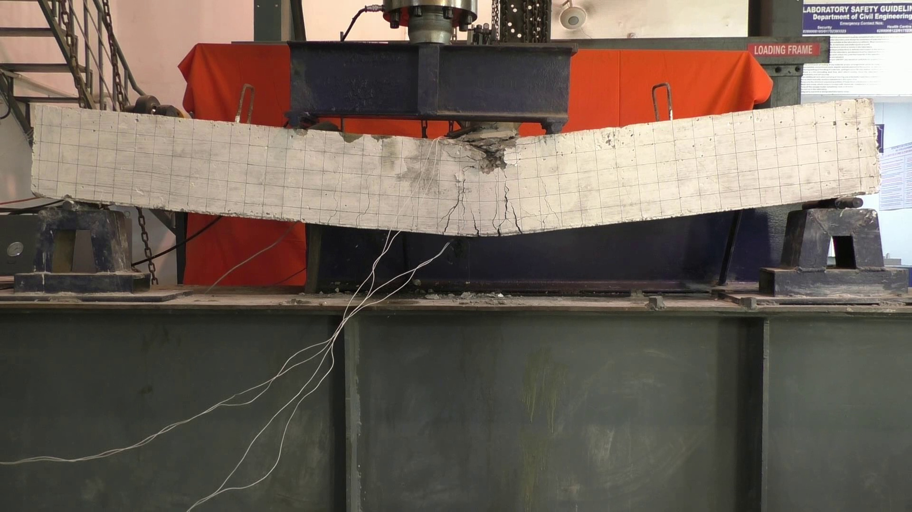

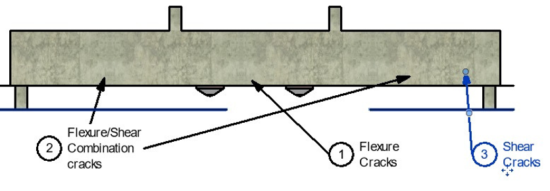


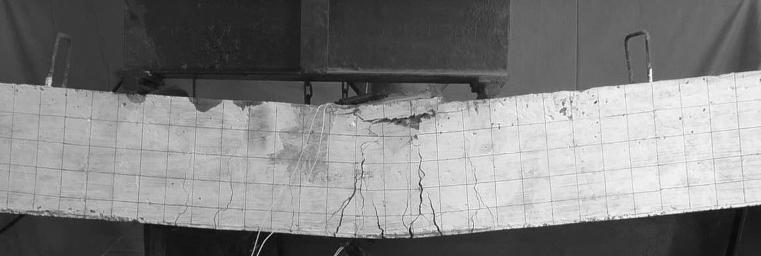
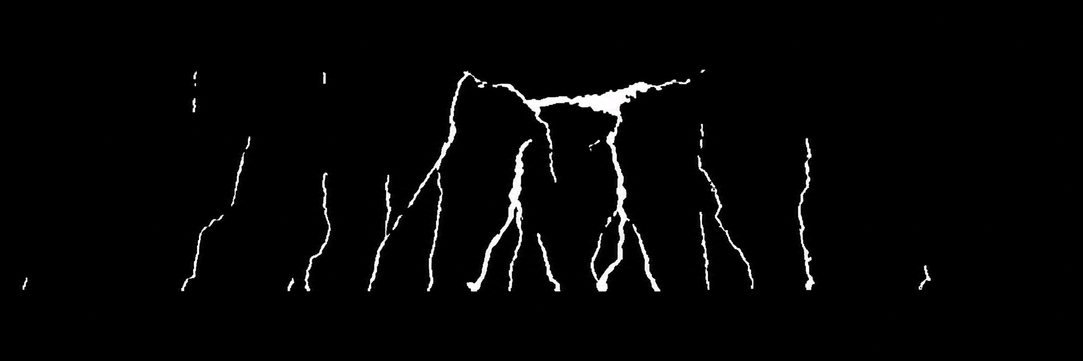
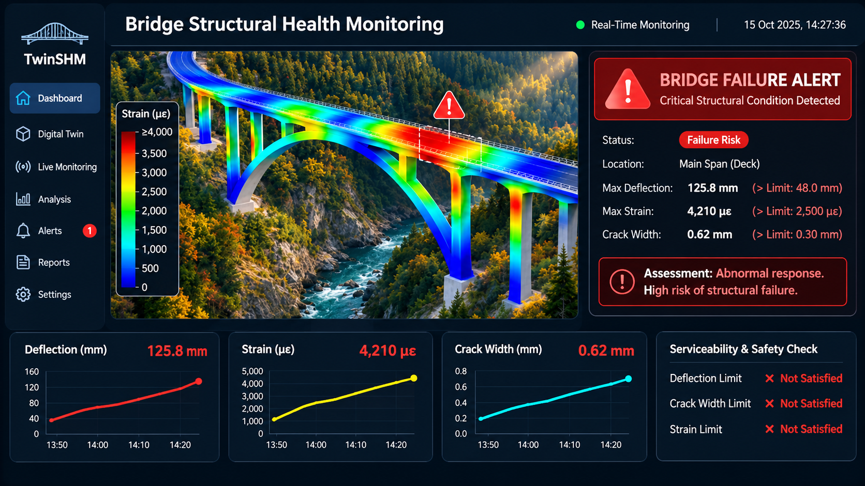
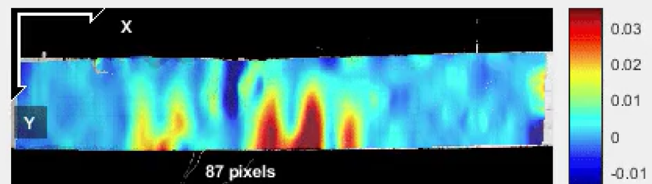
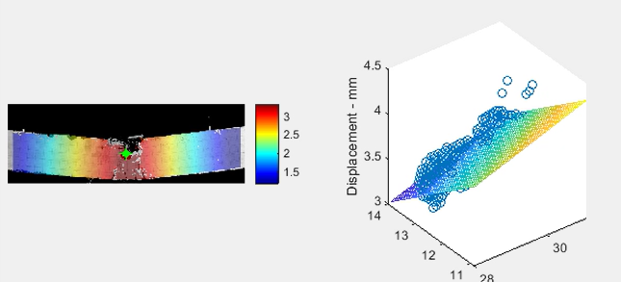
Model Architecture
Sensors Data
Strain
Displacement
4 Point Loading on Beam
Calculation of Deflection and Crack (IS 456)
Stress
Safety Architecture
Image Analysis
Revit Digital Twin Mapping
Final Structural Mapping
Data- Connectors
Pre-Failure Alerts/
Warming
Input Videos
Videos Frame Extraction
ROI Selection
Crack Location
Speckle Gray scaling
Crack Detection
Video Analysis
Stress Profile
Run DIC Analysis
Input to
DIC Setup
ROI Selection
Run DIC Analysis
Strain-Displacement Profile
Alert Monitoring Dashboard

